Slide 1
PSO Week 11
CS 448: Introduction to Relational Database Systems

Slide 2
Concurrency Control
Lock Types
Shared (SLock): For Reads
Exclusive(XLock): For Writes, but can Read too

Slide 3
Two Phase Locking(2PL)
Growing Phase: Transactions only requests locks, can not release. It is upto the lock-manager to grant or deny access to a lock.
Shrinking Phase: Transactions only release locks, can not request new locks once the growing phase is over.

Slide 4
Two Phase Locking(2PL) Algorithm
• When a transaction Ti issues a read(Q) operation, the system issues a SLock(Q) instruction followed by the read(Q) instruction.
• When Ti issues a write(Q) operation, the system checks to see whether Ti already holds a shared lock on Q. If it does, then the system issues an upgrade(Q) instruction, followed by the write(Q) instruction. Otherwise, the system issues a XLock(Q) instruction, followed by the write(Q) instruction.
• All locks obtained by a transaction are unlocked after that transaction commits or aborts.

Slide 5

Example 1
Tx1 | Tx2
XLock(1)
R(1)
W(1)
 | XLock(1)
R(1)
Commit
 | W(1)
 | Commit
Lock Manager
Access granted (Tx1→ 1)
Access Denied
Released (Tx1→ 1)
Access granted (Tx2→ 1)
Released (Tx2→ 1)
Notes:
1 is block 1 of a same table that the transactions are working on.
Problems: 1. cascading rollbacks 2. Deadlocks

Slide 6
Concurrency Control in SimpleDB
A simple two phase locking
Block level locking
Offers simple deadlock detection
Notes:
All operation starts after acquiring all the locks
All locks are released on commit or abort
Deadlock is detected based on timeout

Slide 7
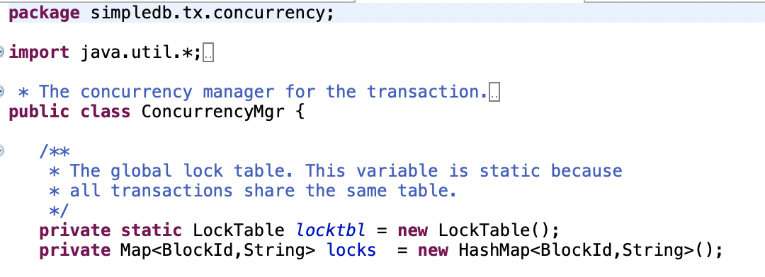
Two-phase Locking (2PL) SimpleDB
Keeps a global lock table which is shared among all transactions
Keeps a local list of locks that is private to this transaction only
Notes:
This is a code snippet from the ConcurrencyMgr of SimpleDB

Slide 8
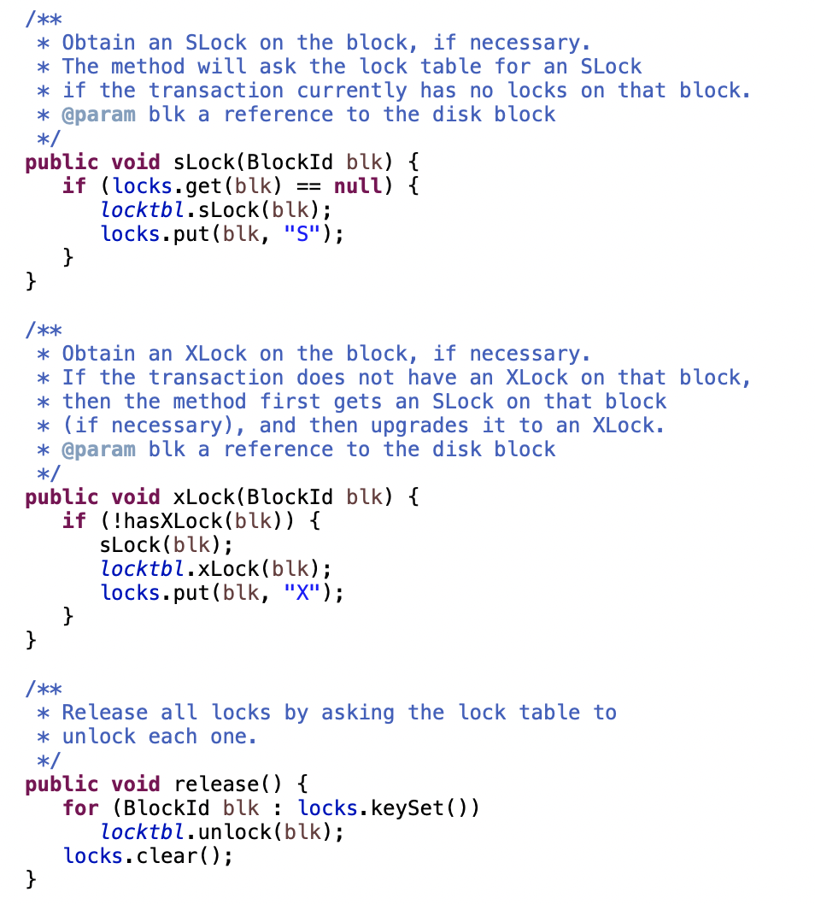
Two-phase Locking (2PL) SimpleDB
Notice how SLock, XLock follows the algorithm stated earlier
This function is called when a transaction commits and releases all locks
Notes:
This is a code snippet from the ConcurrencyMgr of SimpleDB

Slide 9
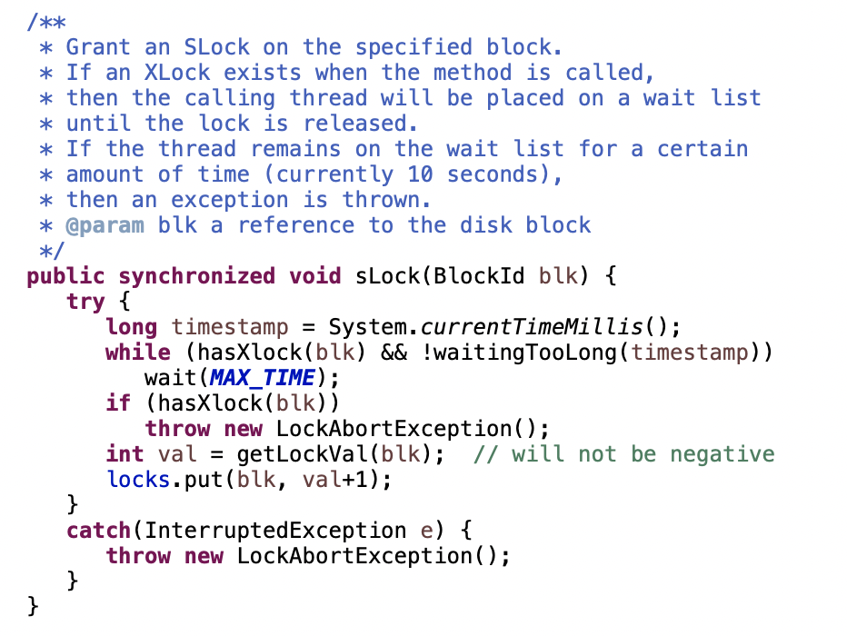
Block Level Locking (SLock)
Deadlock is detected based on timeout

Slide 10
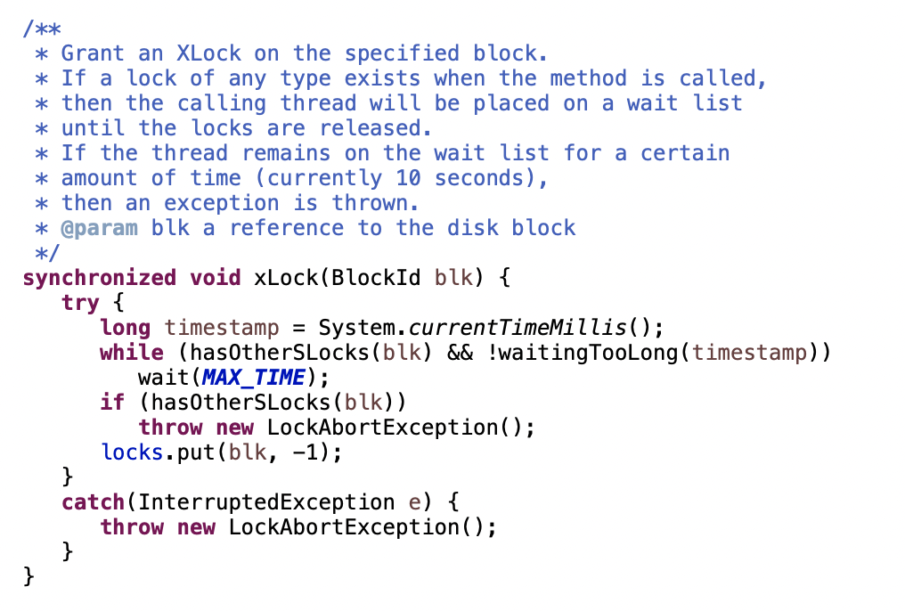
Block Level Locking(XLock)
Deadlock is detected based on timeout

Slide 11
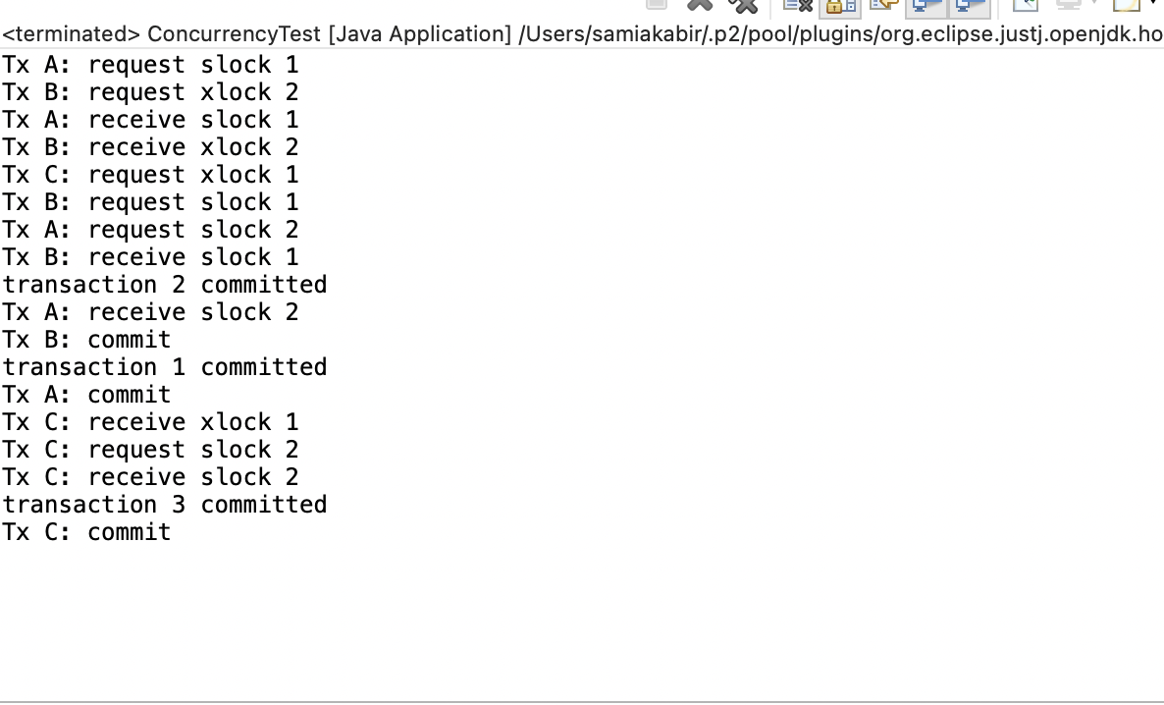
ConcurrencyTest.java
Notes:
Output for a concurrency test in simpledb. Code can be found inside simpledb.transaction

Slide 12
Rooms for improvement?
Better deadlock detection and handling?
Cascading Rollback handling?
Page level or tuple level locking?
Notes:
What do you think??

Slide 13
Reference
https://15445.courses.cs.cmu.edu/fall2018/slides/17-twophaselocking.pdf
https://www.db-book.com/db7/

